Slide 1
The National Center for Health Statistics (NCHS) Data Presentation Standards for Proportions
The Data Presentation Standards for Proportions include criteria based on:
the effective sample size
the width and relative width of the confidence intervals (CIs)
the degrees of freedom
Estimates identified as unreliable will be suppressed.
Estimates flagged for statistical review may be suppressed or presented, depending on the outcome of the review.
When an estimate is flagged or suppressed, a footnote indicating the reason the estimate has been flagged or suppressed should be provided in the publication.

Slide 2
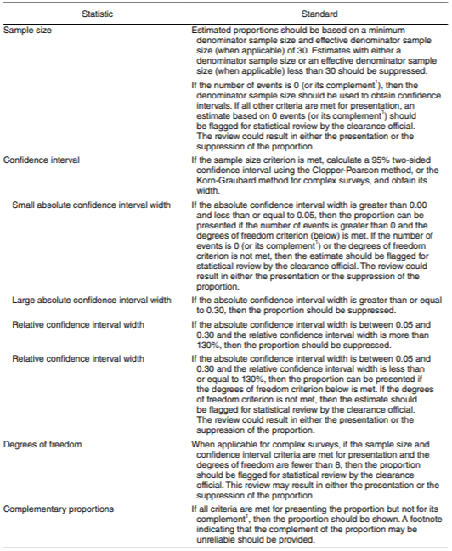

Slide 3
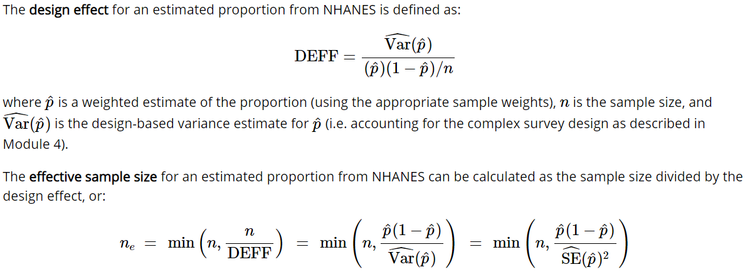
Sample Size and Effective Sample Size
The NCHS Data Presentation Standards for Proportions require that an estimated proportion be suppressed if it is based on either an actual sample size smaller than 30 or an effective sample size smaller than 30.
The sample size is the (unweighted) number of survey participants included in an estimate.
The design effect is the ratio of the variance of a statistic which properly accounts for the complex sample design to the variance of the same statistic based on a simple random sample of the same size.
.

Slide 4
%macro presentation_Code (percent, sepercent, p, sep, nsum, df);
*p and its standard error should be between 0 and 1. check if user has enetred a percent or a proportion;
data check;
%if &percent. ^= %then %do;
p=&percent./100;
sep=&sepercent./100;
q=1-p;
%end;
%else %if &p. ^= %then %do;
p=&p.;
sep=&sep.;
q=1-p;
%end;
nsum=&nsum.;
df_flag=0;
*check if user entered a df value. If not, then set df to sample(nsum)-1;
%if &df. = %then %do;
df=nsum-1;
%end;
%else %do;
df=&df.;
if df < 8 then df_flag=1;
%end;
*effective sample size;
if (0 < p < 1) then n_eff = (p*(1-p))/(sep**2);
else n_eff=nsum;
if (n_eff=. or n_eff > nsum) then n_eff=nsum;

Slide 5

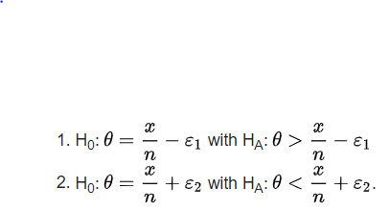
Clopper–Pearson interval
This is often called an 'exact' method, because it is based on the cumulative probabilities of the binomial distribution (i.e., exactly the correct distribution rather than an approximation: ).
The Clopper–Pearson interval is
with confidence level
, such that the following tests of hypothesis
succeed with significance :
Because of a relationship between the binomial distribution and the beta distribution, the Clopper–Pearson interval is sometimes presented in an alternate format that uses quantiles from the beta distribution.
The beta distribution is, in turn, related to the F-distribution so a third formulation of the Clopper–Pearson interval can be written using F quantiles:

Slide 6

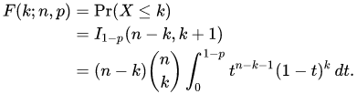
The cumulative distribution function of the binomial distribution can be expressed as:
It can also be represented in terms of the regularized incomplete beta function, as follows:
which is equivalent to the cumulative distribution function of the F-distribution:

Slide 7

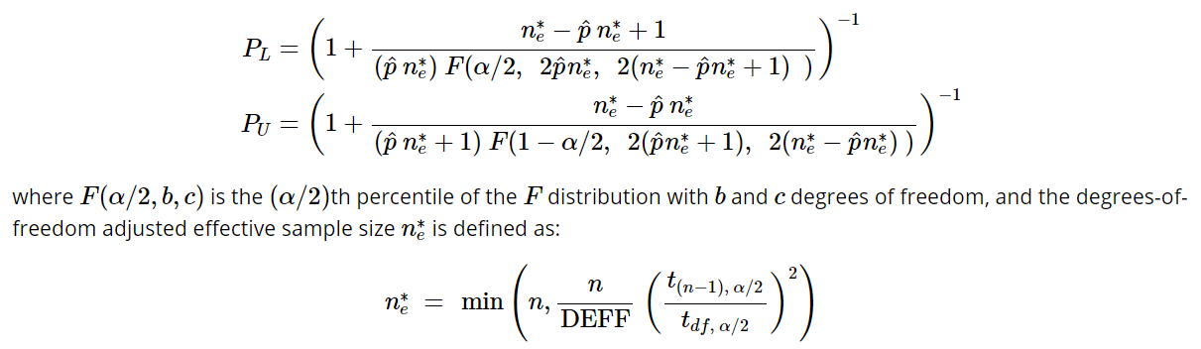
Korn and Graubard confidence interval
Korn and Graubard adjusted the Clopper-Pearson interval for complex surveys, replacing sample size n with degree of freedom
adjusted effective size and positive outcomes with

Slide 8
Degrees of Freedom and the Reliability of the Estimated Standard Error
A proportion based on fewer than 8 degrees of freedom should be reviewed whether to present or suppress the proportion.
Degrees of freedom = number of PSU – number of strata
For one 2-year cycle: degrees of freedom = 30 PSU – 15 strata = 15.
Subgroups may have fewer than 15 degrees of freedom.

Slide 9
*********************************Evaluate KG CI********************************;
*Ratio of ts: adjustment to sample size suggested by Korn and Graubard for complex survey data;
*A two-sided a (0.05/2 or 0.025) is used in the equation below: 1-0.025 = 0.975 ;
if df > 0 then rat_squ=(tinv(.975,nsum-1)/tinv(.975,df))**2; else rat_squ=0; *limit case: set to zero;
*df-adjusted effective sample size (can be no greater than the sample size);
if p > 0 then n_eff_df=min(nsum,rat_squ*n_eff);
else n_eff_df=nsum; *limit case: set to sample size;
*Parameters for beta confidence limits; x=n_eff_df*p;
v1=x; v2=n_eff_df-x+1; v3=x+1;
v4=n_eff_df-x;
*lower and upper confidence limits for Korn and Graubard interval
*Note: Using inverse beta instead of ratio of Fs for numerical efficiency. The BETAINV(p, a, b) function returns the pth quantile from the beta distribution with shape parameters a and b.
*if (0<p<1), otherwise set lower limit to 0 when p=0 and upper limit to 1 when p=1
*A two-sided a (0.05/2 or 0.025) is used in the equations below: 0.025 and 0.975;
if (v1=0) then kg_l=0;
else kg_l=betainv(.025,v1,v2);
if (v4=0) then kg_u=1;
else kg_u=betainv(.975,v3,v4);

Slide 10
Relative Confidence Interval Width for Proportions
The relative confidence interval width (RCIW) is calculated as the absolute CI width divided by the proportion and multiplied by 100%.
Absolute CI Width | Relative CI Width | Guidance
≥30% | Any level | Suppress
>5% and <30% | >130% | Suppress
>5% and <30% | ≤130% | Present*
≤5% | Any level | Present*

Slide 11
*Korn and Graubard CI absolute width; kg_wdth=kg_u - kg_l;
pct_kg_l= kg_l *100;
pct_kg_u= kg_u *100;
length CI $25;
CI=compress(left(&percent.))||' ('||strip(put(pct_kg_l,5.1))||', '||strip(put(pct_kg_u,5.1))||')';
*Korn and Graubard CI relative width for p;
if (p>0) then kg_relw_p=100*(kg_wdth/p); else kg_relw_p=.;
*Korn and Graubard CI relative width for q;
if (q>0) then kg_relw_q=100*(kg_wdth/q); else kg_relw_q=.;
*Proportions with CI width <= 0.05 are reliable, unless Effective sample size is less than 30;
p_reliable=1;
if n_eff < 30 then p_reliable=0;
*Absolute CI width is greater than or equal 0.30; else if kg_wdth ge 0.30 then p_reliable=0;
*Relative CI width is greater than 130%;
else if (kg_relw_p > 130 and kg_wdth > 0.05) then p_reliable=0;

Slide 12
*Determine if estimate should be flagged as having an unreliable complement;
if (p_reliable=1) then do;
*Complementary proportions are reliable unless relative CI width is greater than 130%;
q_reliable=1;
if (kg_relw_q > 130 and kg_wdth > 0.05) then q_reliable=0; end;
p_staistical=0;
if p_reliable=1 then do;
*Estimates with df < 8 or percents = 0 or 100 or unreliable complement are flagged for statistical review;
if df_flag=1 or p=0 or p=1 or q_reliable=0 then p_staistical =1;
end;
run;
%mend Presentation_Code;
%presentation_Code (13.6, 2.6, , , , 15);

Slide 13
Relative Standard Error
%RSE = (Standard error of estimate / Estimate) * 100
Estimated means with RSE greater than or equal to 30% should be identified as unreliable.

Slide 14
Disadvantages of the SAS Macro
For each proportion, need to input proportion/percentage, standard error, sample size and degrees of freedom.
If degrees of freedom is not entered, df is assigned as n-1, which is not accurate.
KG CI estimation is already available in proc surveyfreq (SAS) and svyciprop (r).
Need to include RSE estimation for the mean estimates.
proc surveyfreq data=ANALYSIS_DATA;
cluster sdmvpsu;
stratum sdmvstra;
Table riagendr/cl(type=CP);
weight wtmec2yr;
RUN;
svyciprop(~bp_cat + cycle, survey_design, method="beta")

Slide 15
Suggestions
Do the proc surveyfreq inside the SAS Macro.
Use the outptut from proc surveyfreq to automatically acquire all the parameters for the SAS Macro.

